Slide 1
Cafe Great – Sales Analysis
Assignment presented by:
Tanukrishna Chetia

Slide 2
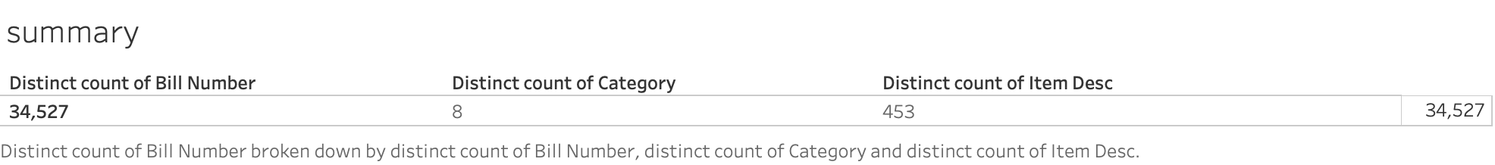
SUMMARY
We are hereby performing sales analysis for Café Great. Thus we are identifying how the restaurant has performed through the given period and what could help to improve their sales. We are also creating combos by seeing what have usually been purchased together. Further, we have performed the below detailed analysis as required:
Exploratory Analysis of data.
Trends noticed in terms of consumer behavior over different times of the day and different days of the week.
Concrete recommendations for sales improvement and removal of redundant items.
Sale trends drawn for the period.

Slide 3
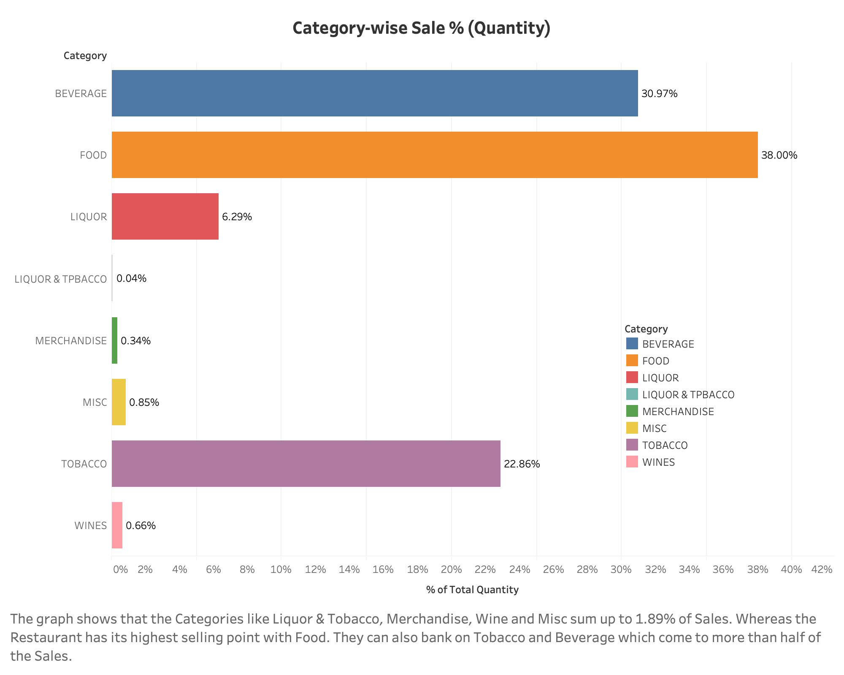

Slide 4
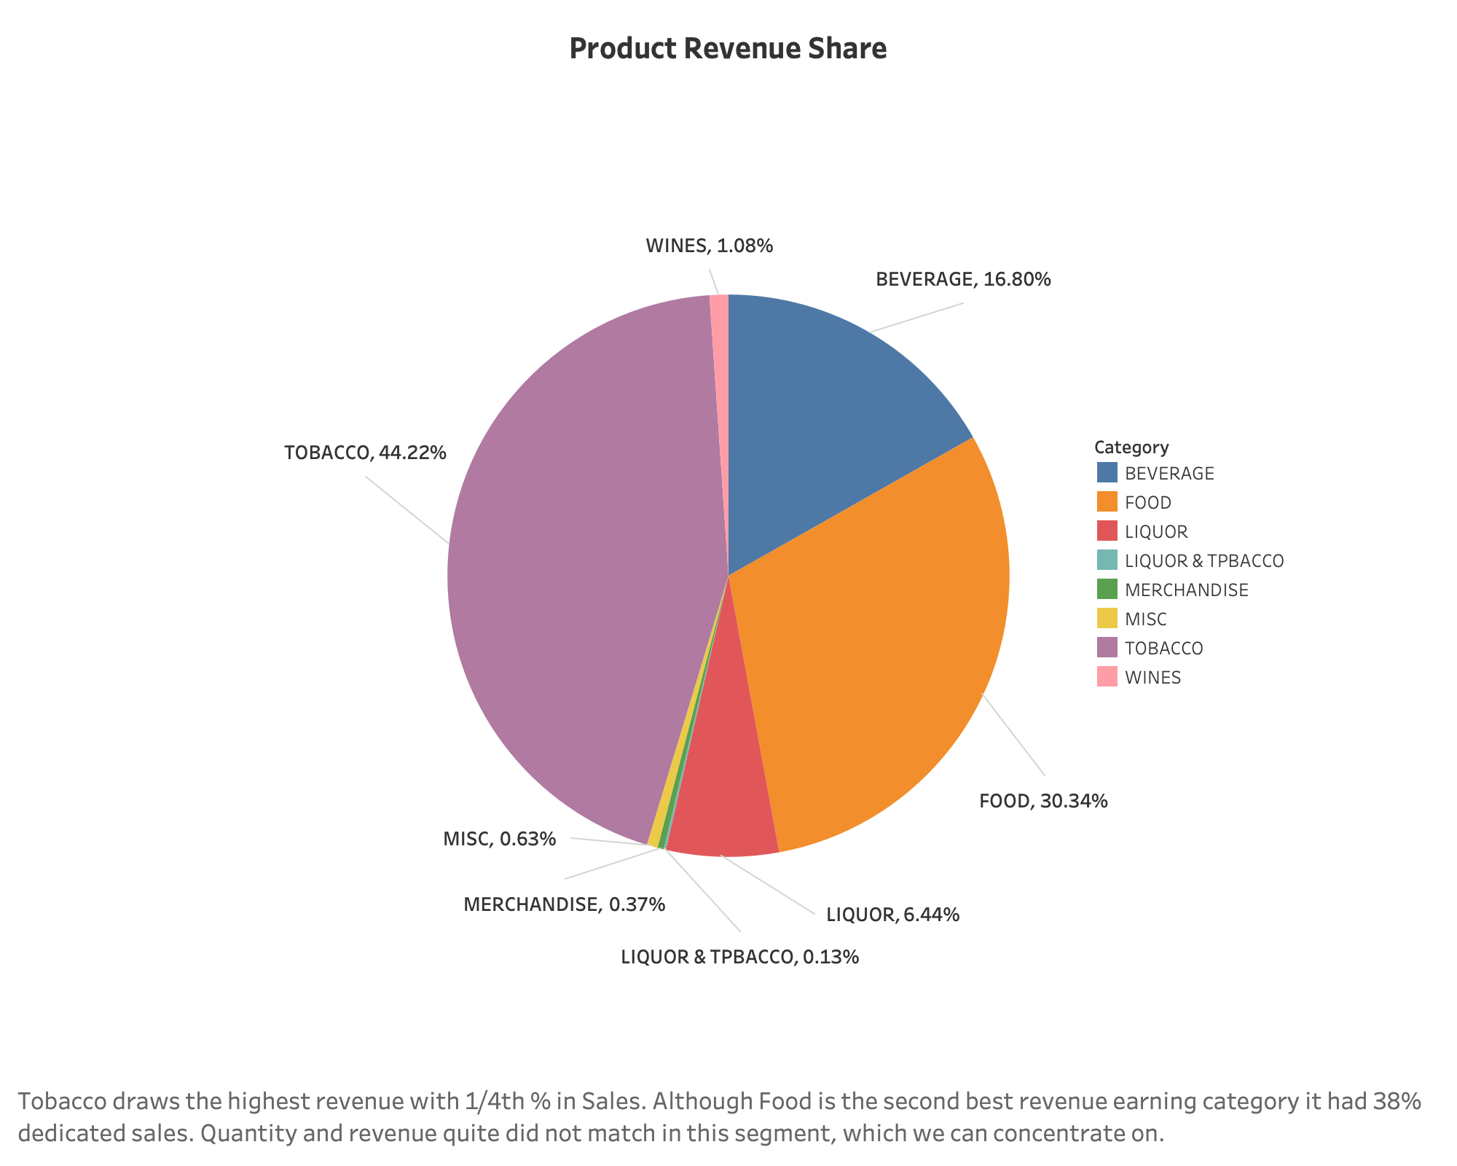

Slide 5
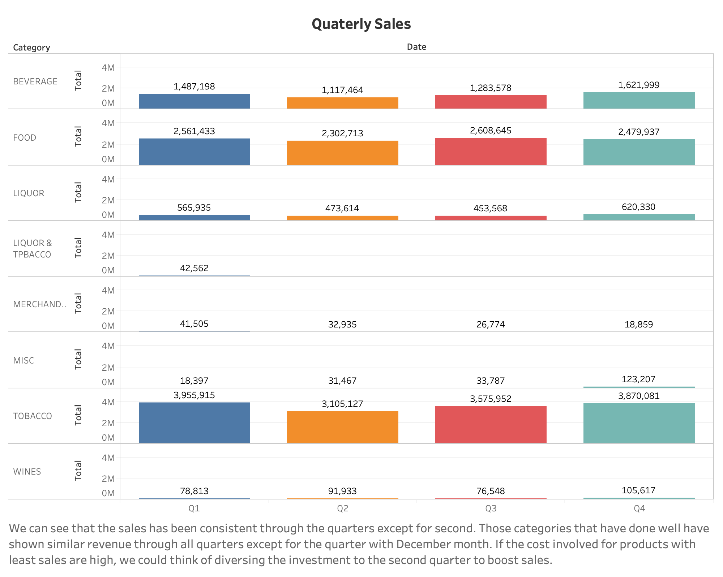

Slide 6
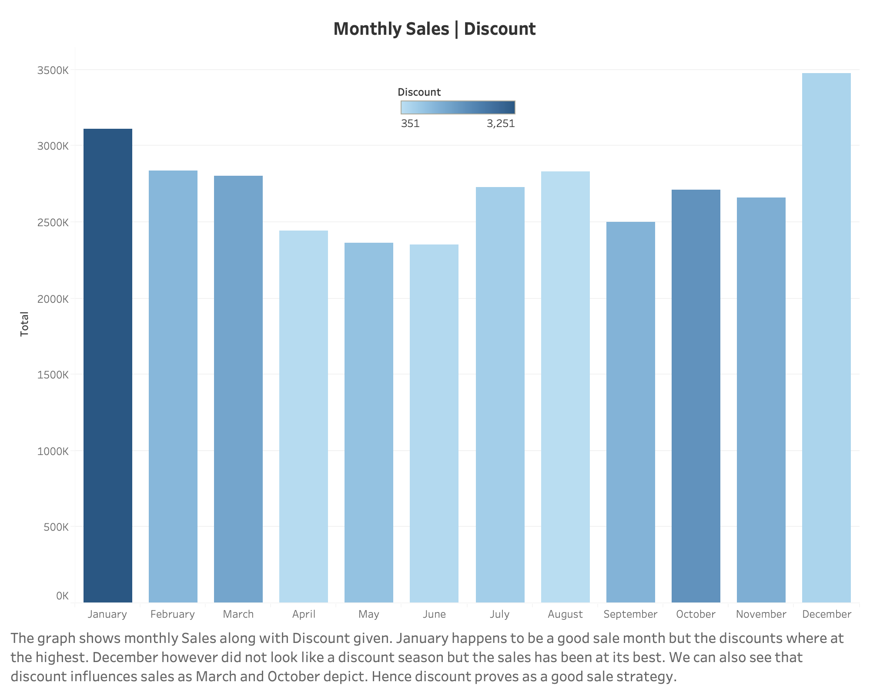

Slide 7
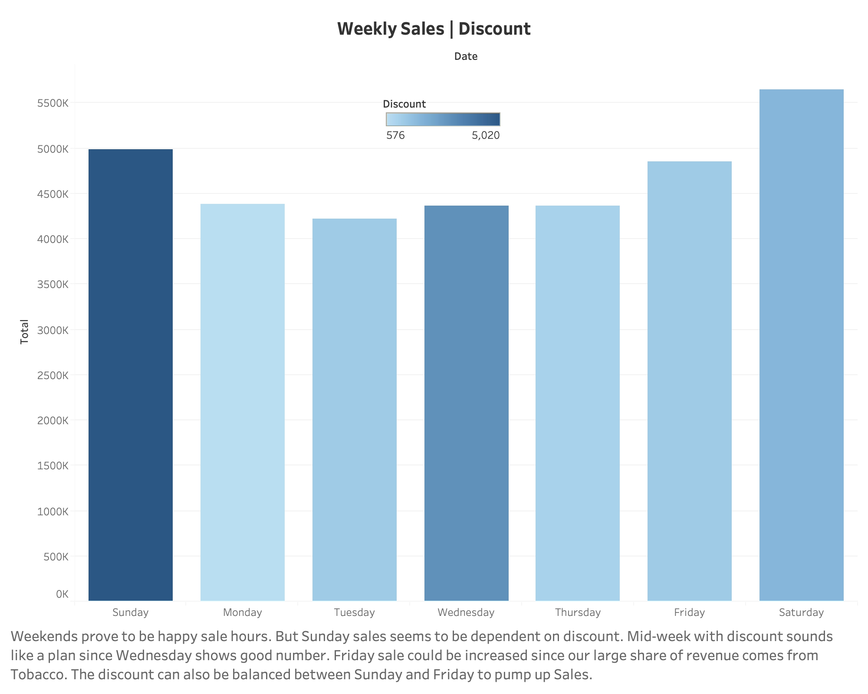

Slide 8
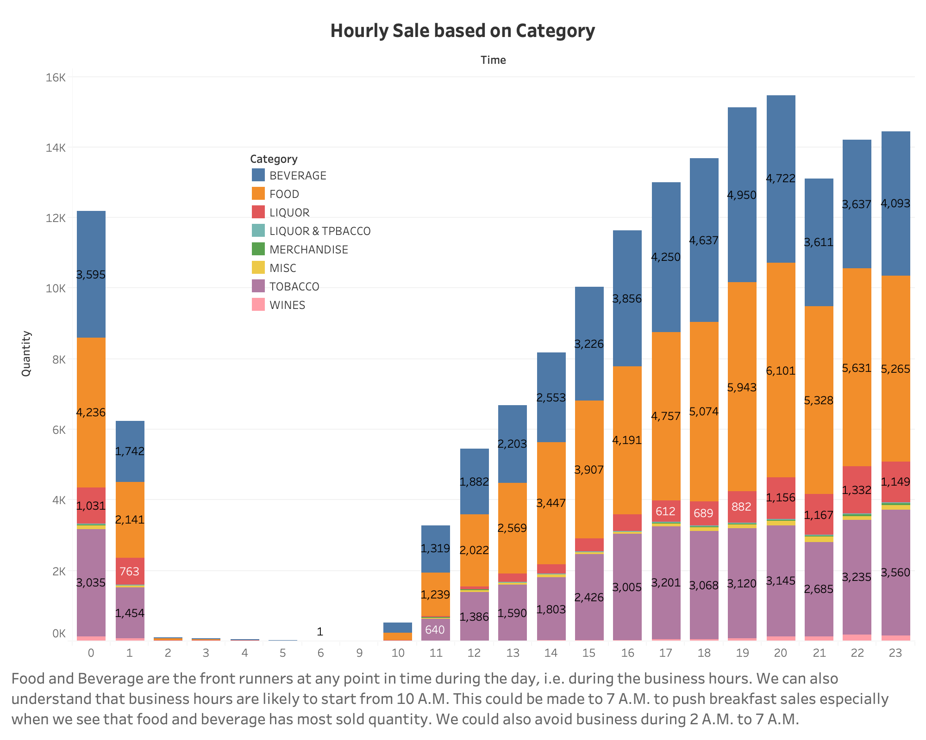

Slide 9
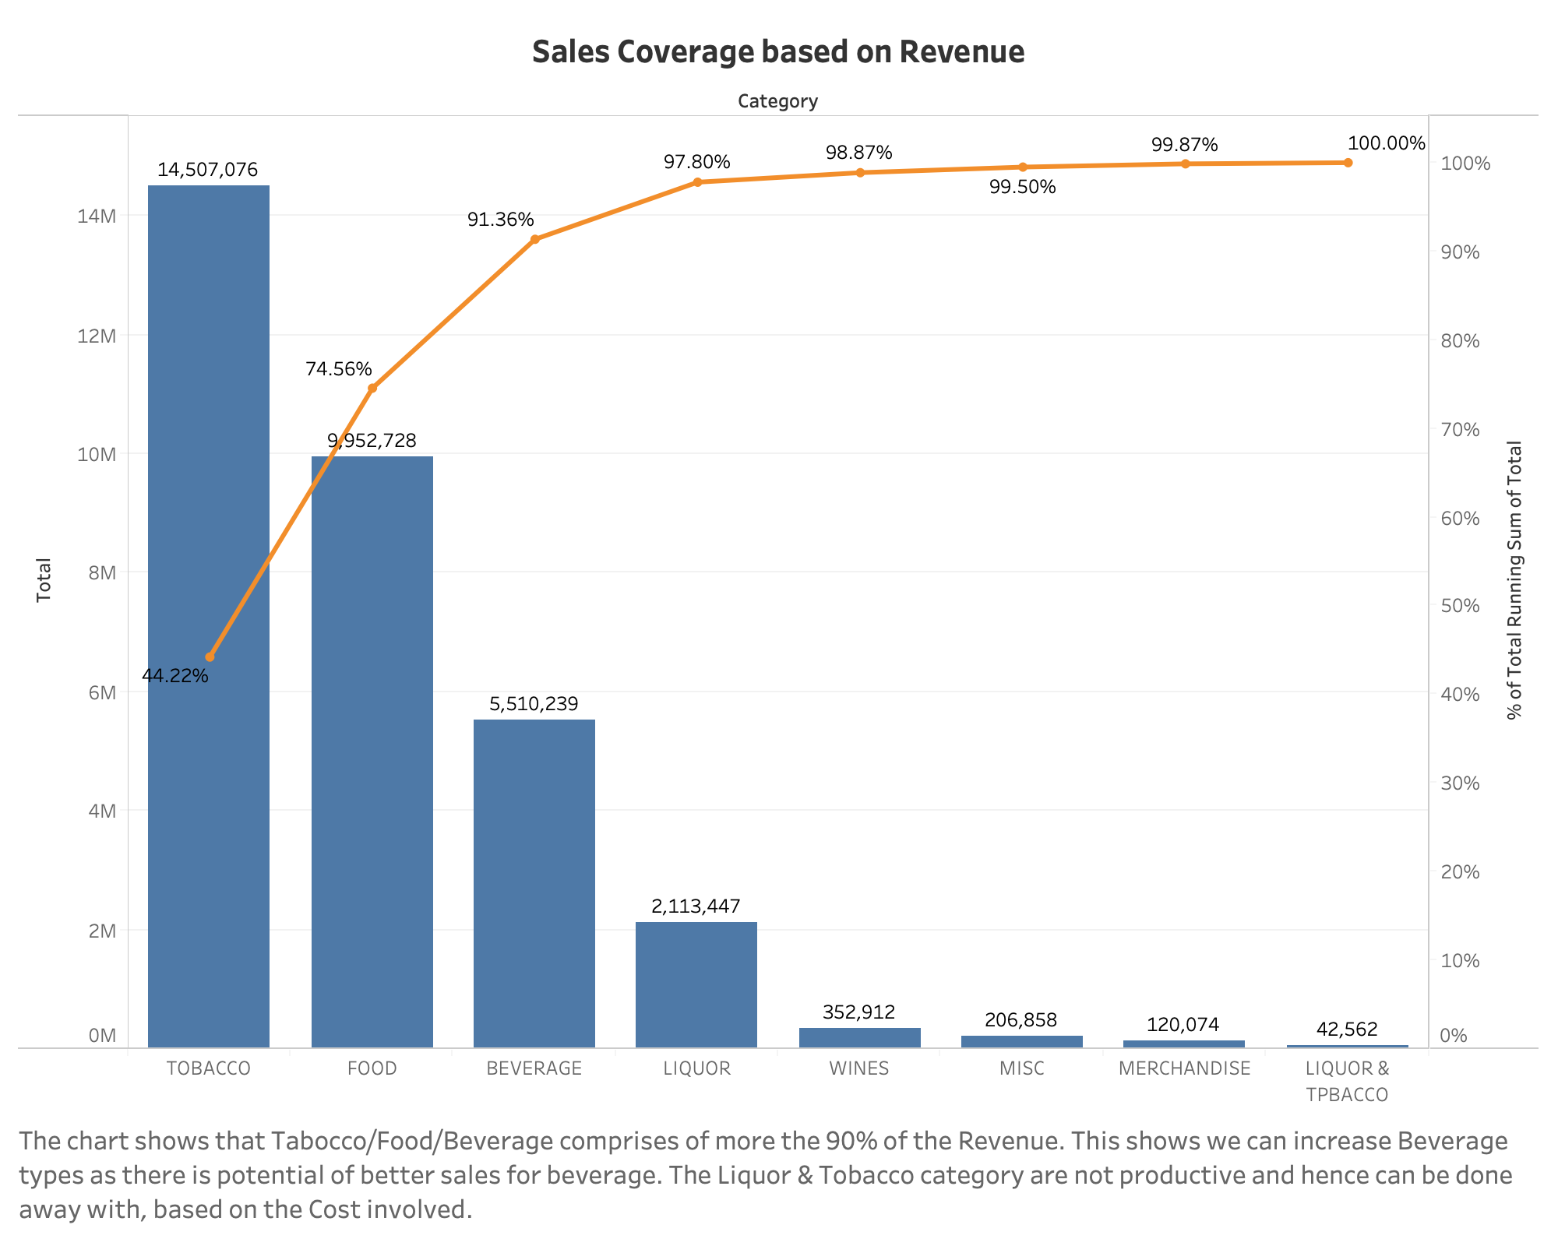

Slide 10
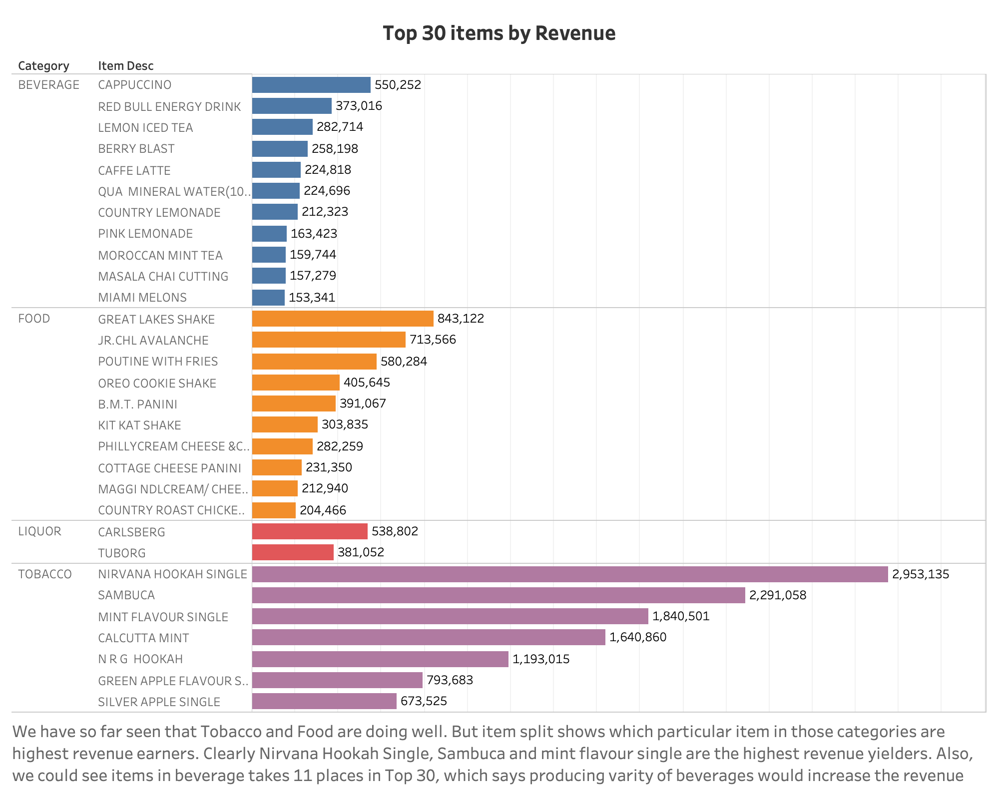

Slide 11
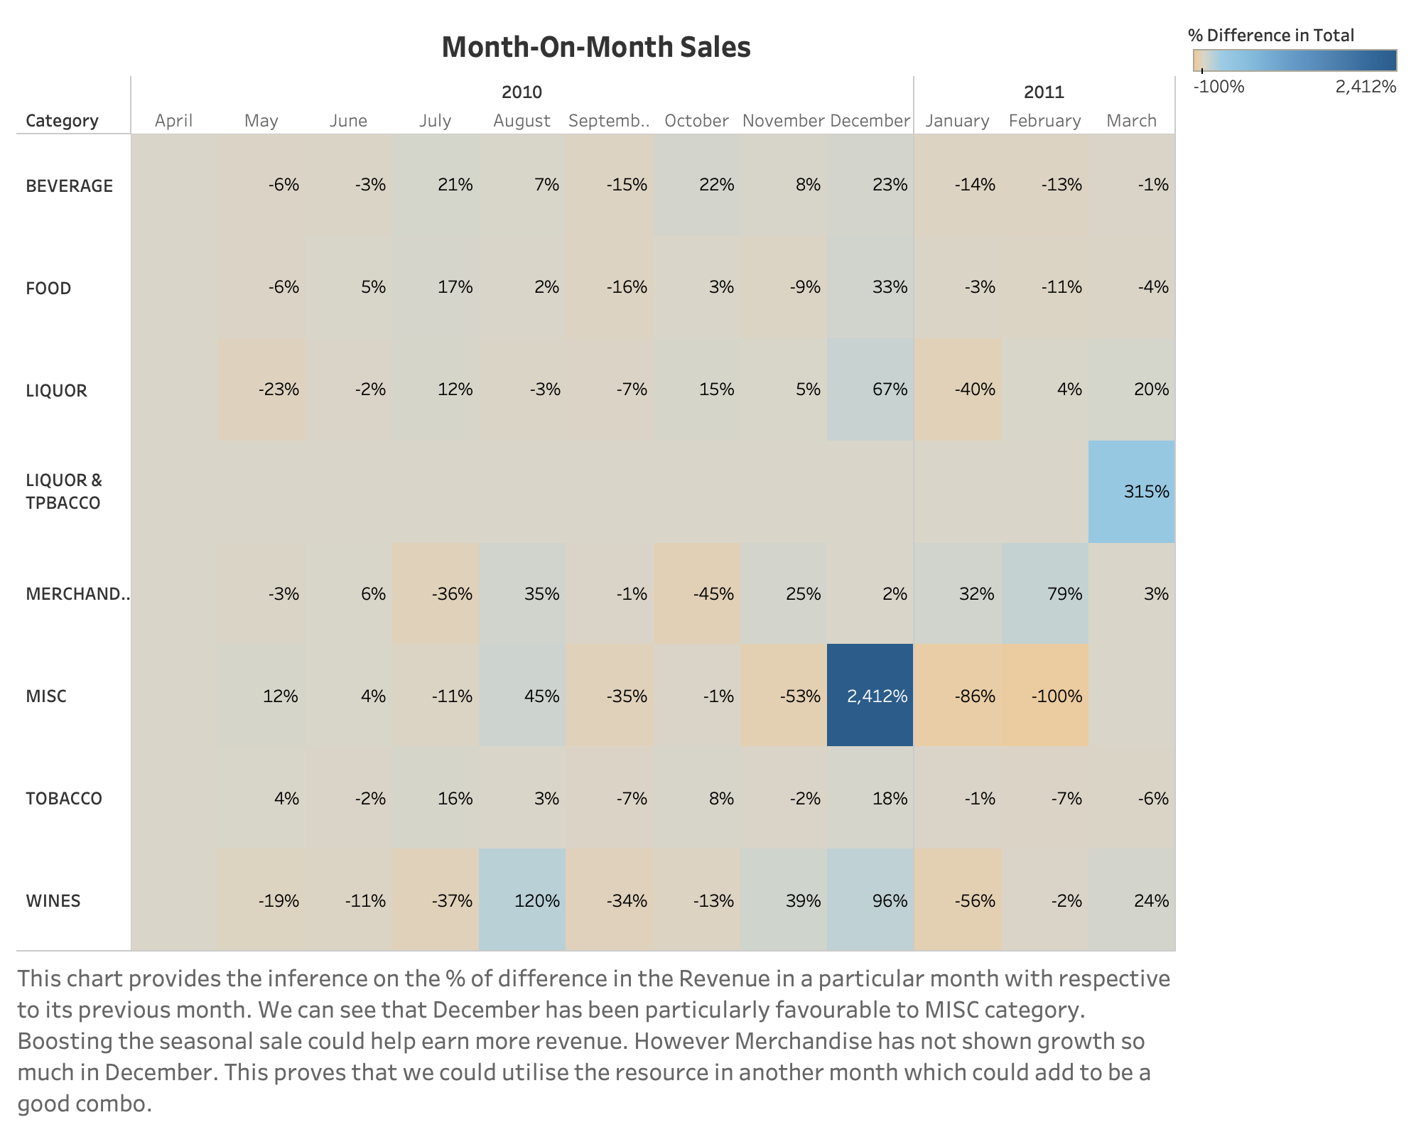

Slide 12
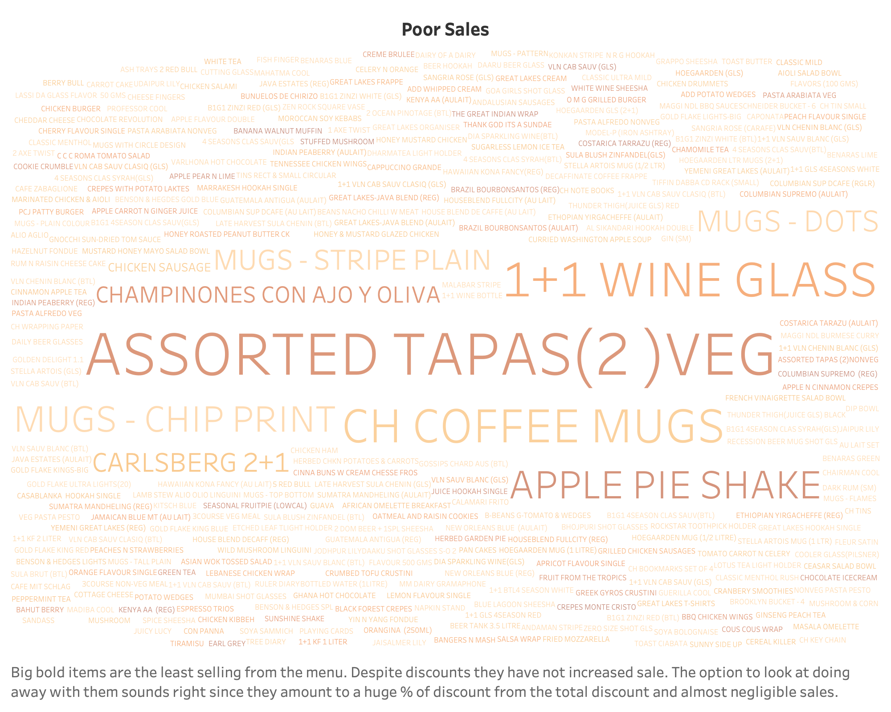

Slide 13
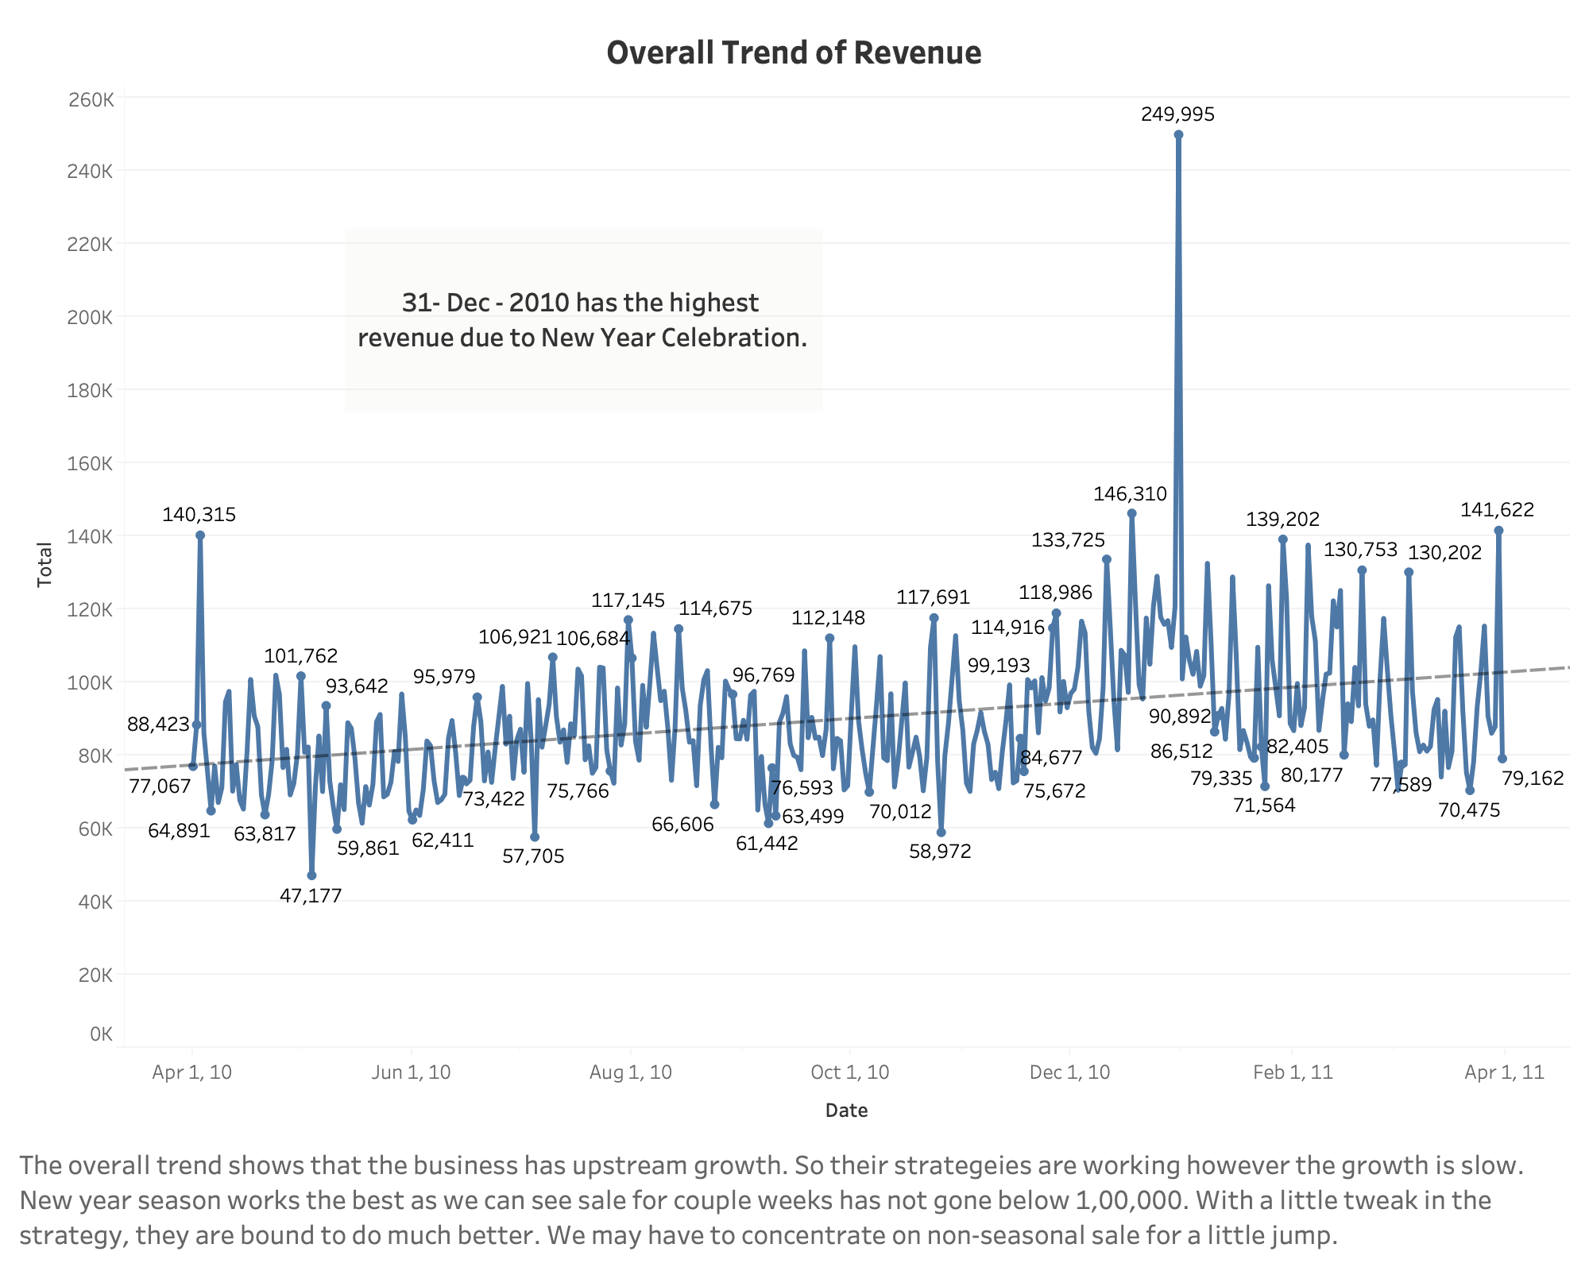

Slide 14
COMBOS SUGGESTED BASED ON FREQUENT PURCHASE IN SINGLE BILL
B.M.T. PANINI | <--- | [FRENCH FRIES]
LEMON INFUSED CHAR GRILLED VEG | <--- | [ADD HERB ROAST CHICKEN]
GREAT LAKES SHAKE | <--- | [VANILLA ICECREAM]
CAPPUCCINO | <--- | [ADD HAZELNUT FLAVOUR]
CAFFE LATTE | <--- | [ADD HAZELNUT FLAVOUR]
B.M.T. PANINI | <--- | [ADD FRIES]
NIRVANA HOOKAH SINGLE | <--- | [QUA MINERAL WATER(500ML)]
SAMBUCA | <--- | [RED BULL 2+1]

Slide 15
INFERENCE
This restaurant is influenced by seasonal sales.
Discounts have not been very effective and hence they will have to work on items that are second best and quarters that are usually dull and induce discounts in them.
There are item categories like Misc and Merchandise we can completely do away with since the sales is very meagre despite efforts.
Branding and advertisement can pick up with festivals and celebrations as they seem to draw higher sales.
We also see that the restaurant is doing well like the trend suggests but with slight tweak they will earn higher profits.
Any discounts on Tobacco can be cancelled as they can be considered their Premium product.

